Slide 1
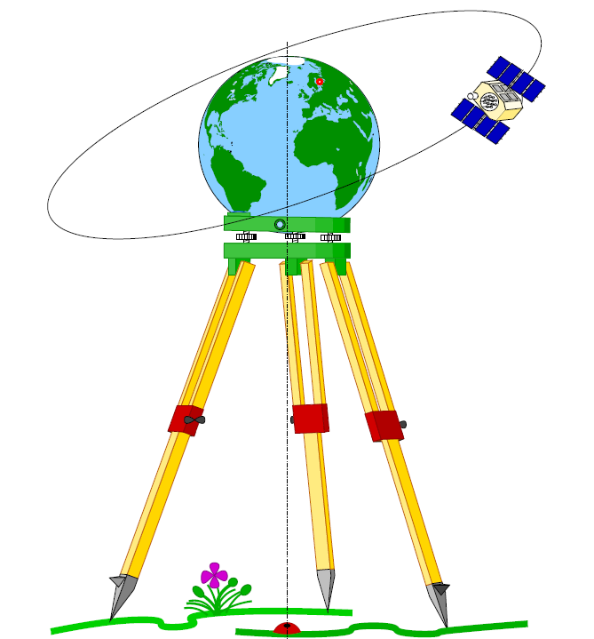
Geodesy

Slide 2
Transformations
With many of different terrestrial reference systems, as well
as local or regional or global datums, it is important in
geodetic applications, it is required to know the relationship
between the coordinates of points in these systems.
Especially for the realization of ITRF, extensive use of
transformations is made to define the evolution تطور of the
realizations and the relationships of ITRF to realize of
reference systems of contributing analysis centers or space
techniques.
ITRF: International terrestrial Reference frame

Slide 3
The transformations of traditional local horizontal datums
(referring to an ellipsoid) with respect to each other and with
respect to a global terrestrial reference frame is a topic beyond
the present scope.
However, for standard Cartesian systems, like the ITRF and
WGS84, and even other modern realizations of regional datums
(like the European Coordinate Reference Systems ECRS), a
simple 7-parameter similarity transformation (Helmert
transformation) serves as the basic model for the
transformations.
ITRF : International terrestrial Reference frame
WGS84 : World Geodetic System, 1984

Slide 4
According to the definition of the IERS; International Earth
Rotation and Reference Systems Service; the transformation
model is given by:
Xto = T + D . R^{T} Xfrom
Where Xto is the coordinate vector of a point in the frame to which its coordinates are transformed, and Xfrom is the vector of coordinates of that same point in the frame from which it is transformed.
The translation, or displacement, between frames is given by the vector, T , and the scale difference is given by D .

Slide 5
The IERS definition concerning the rotations between frames, where the
rotation matrix, here denoted R^{T} , represents rotations angles in the
negative (clockwise) sense, rather than the usual positive (counter
clockwise) sense; see Figure below.
Since the rotation angles are small, we have from equation:
where R1, R2 , and R3 are the small rotation angles, in the notation and definition of the IERS.

Slide 6
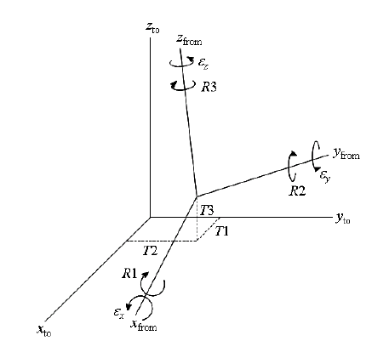

Slide 7
NAD83 : North American Datum

Slide 8
So we have 7 transformation parameters:
3 translation parameters T1, T2, T3
3 rotation parameters R1, R2, R3
1 scale factor D
These 7 parameters are unknown.
So that, it is required to form 7 equations to solve this problem.
To determine these 7 parameters, we need known the
coordinates (x, y, z) of at least 3 common points in both
systems (to and from systems).
That is because each point gives 3 equations in x-, y-, and z-
direction.

Slide 9
7 transformation parameters for conversion from WGS84 to ITRF-90:
Xo = 0.060
Yo = -0.517
Zo = -0.233
µ = 0.999999989
α1 = -0.0183”
α2 = 0.0003”
α3 = -0.0070”

Slide 10
Transformation between local and geodetic coordinate system
The difference of coordinates between two points P & Q given by:

Slide 11
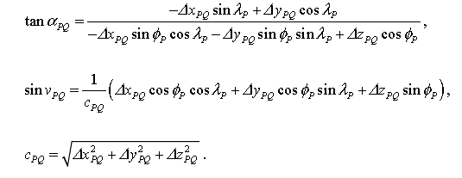
The azimuth, vertical angle and distance between any two points P & Q given by:

Slide 12
The azimuth, vertical angle and distance between any two points P & Q given by:
=

Slide 13
The local coordinate system (x, y, z) can be obtained by two succeeded rotations of the global coordinate system (X, Y, Z) by R2 (90-φ) R3 (λ) and then by changing the x-axis to a right handed system. In other words, the global system has to be rotated around z-axis with angle λ, then around the y-axis with angle (90-φ) and then change the sign of the x-axis. The total transformation matrix R is then:
And there are:
x_{local} = R X_{global}
And
X_{global} = R^{T} x_{local}

Slide 14
Where x_{local} , X_{global} are the same vector represented in local
and global coordinate systems.
(ϕ, λ) are the geodetic latitude and longitude of the local point.
If x_{local} , X_{global} are different vectors, the transformation
given by:
X_{global} = T + D. R^{T} x_{local}

Slide 15
The Affine 4 parameters transformation
The Affine 4 parameters transformation algorithm consists in a roto-
translation between two reference systems.
Mathematically, to transform the coordinates from one reference system
to another, at least the coordinates of 2 points in both systems are
needed.
The figure show the roto-translation schema: Eo and No are the East/North
translations between the origin of the raster system (red axis) and the
origin of the map system (blue axis), whereas ε is the rotation angle
between the two systems. P and Q are the two (minimum) points, known
in the two reference systems, needed to transform raster coordinates
into map coordinates.

Slide 16
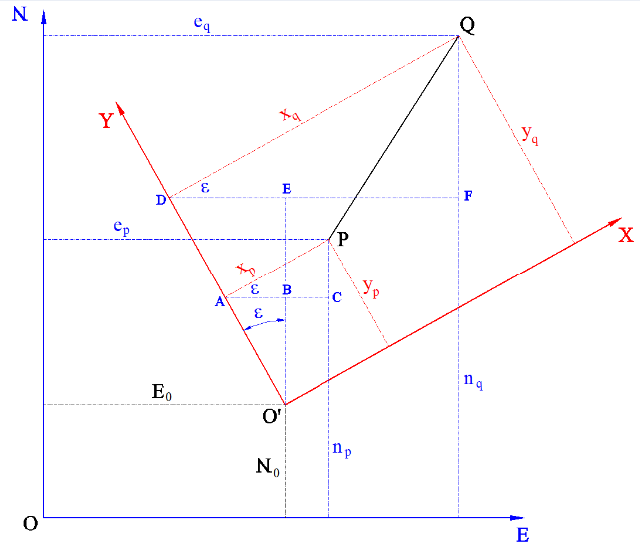

Slide 17
Even though two known points in both systems are sufficient to
solve this transformation, it is obviously advised to use more
points in order to have a more accurate calculation.
Using more than two points implies that a scale factor
between the two systems is generated due to the surplus فائض
of measurements. So, for a generic point P the matrix formula of
this transformation is:

Slide 18
This notation makes quite clear why this transformation is
called “4 Parameters”, there are in fact 4 values we need to
calculate in order to transform the raster coordinates of one
point into its corresponding map coordinates.
These 4 parameters are: Eo, No, f, ε, i.e. the two East/North
translations of the raster origin, the scale factor and the
rotation angle.

